Slide 1
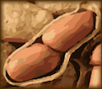
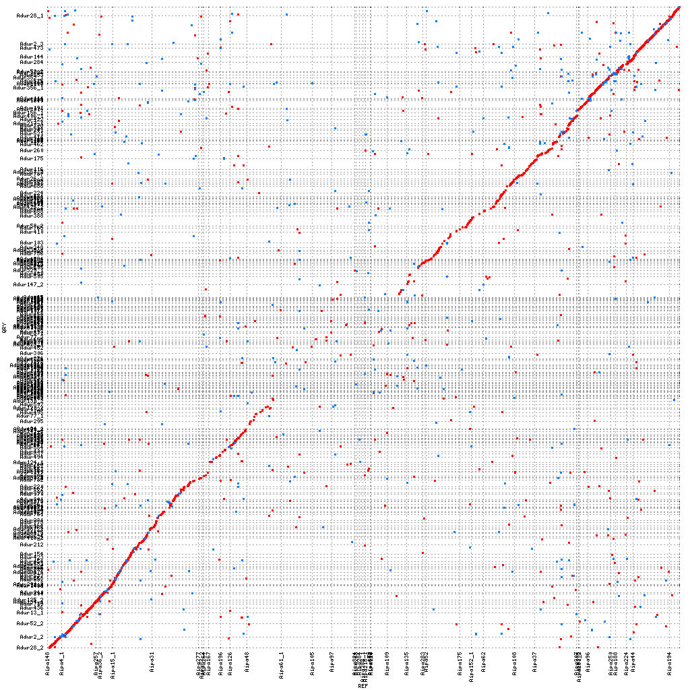
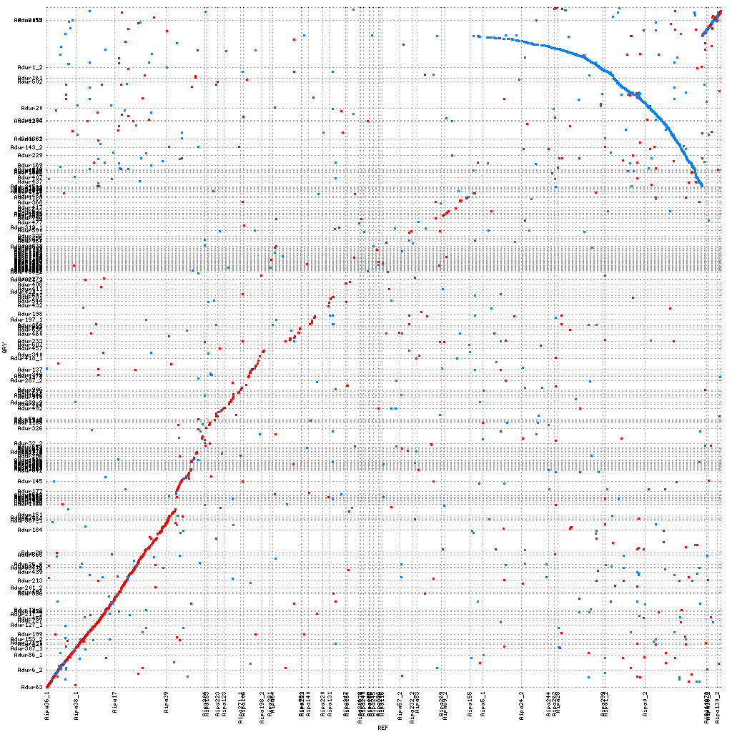
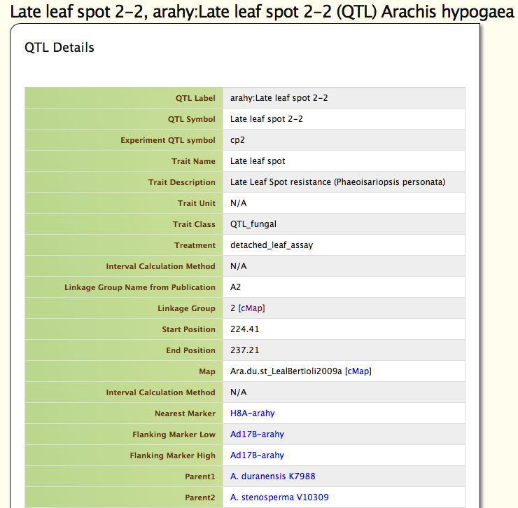
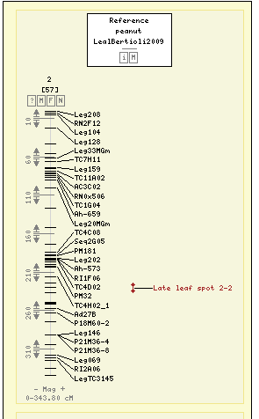
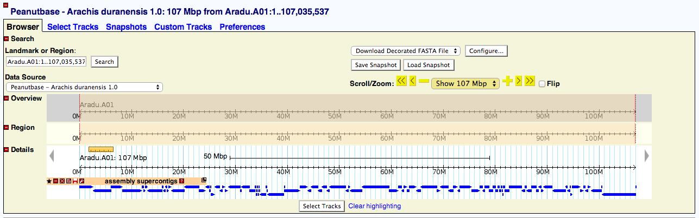
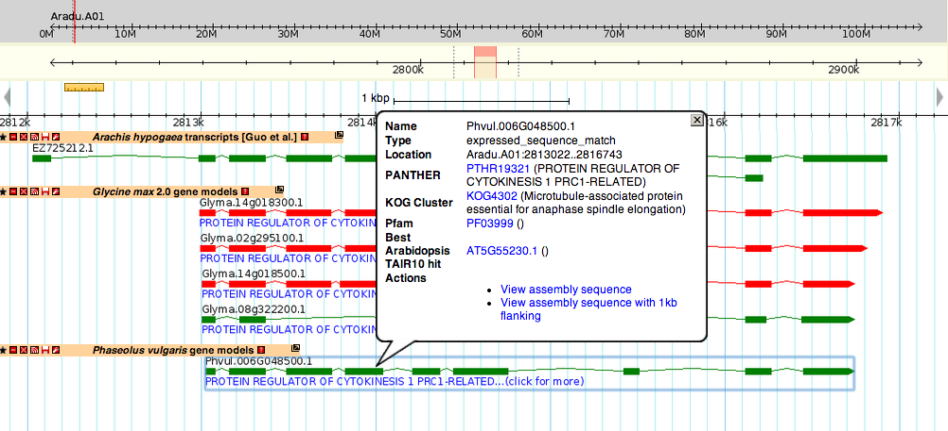





PeanutBase.org
The Genomic Data Portal for Arachis
Ethalinda K.S. Cannon¹, Sudhansu Dash², Scott Kalberer³, Wei Huang⁴, Nathan Weeks³, Andrew Farmer⁵, Julie A. Dickerson^{1,2}, Steven Cannon^{3,4}
¹ Electrical and Computer Engineering ISU, ISU; ² Virtual Reality Application Center, ISU; ³ USDA-Agricultural Research Service; ⁴ Agronomy, ISU; ⁵ National Center for Genomic Research
PeanutBase provides peanut researchers and breeder with genetic and genomic data for Arachis and provides means for connecting peanut data to closely related plants with more developed datasets, for example, soybean and common bean.
PeanutBase is being developed in collaboration with the Legume Information System (LIS; http://comparative-legumes.org)
Peanut Ancestory
Arachis hypogea, cultivated peanut, is a tetraploid resulting from an alloploidy merging of A. duranensis and A. ipaensis ~10,000 years ago. These progenitor species separated from each other ~3 mya.
Arachis hypogea (Cultivated peanut)
40 chromosomes, AABB
A reference genome assembly for Arachis hypogea
Because of the complexity of the tetrapolid A. hypogea, its diploid progenitor species, A. duranensis and A ipaensis were sequenced and assembled first. Although the two species diverged ~ 3 mya, they still maintain significant synteny, although some large rearrangements have occurred.
Arachis duranensis
20 chromosomes, AA
~10,000 years ago
Arachis ipaensis
20 chromosomes, BB
~3 mya
The two progenitor diploid genomes are remarkably similar….
…but there have been some significant rearrangements as well.
Common ancestor
Traits and QTL maps – Late Leaf Spot example
Both genome assemblies can be explored by genome browser and are available as FASTA downloads.
Gene models have been created for both A. duranensis and A. ipaensis using two methods, MAKER-P and GLEAN and are available as genome browser tracks.
Markers and Sequence Data
Markers associated with QTL can be used to identify likely gene models on the genome assemblies. Comparisons between candidate Arachis gene models and soybean and common bean gene models can suggest candidate genes for the trait of interest.
Arachis gene models can be compared to Glycine max (soybean) and Phaseolus vulgaris (common bean) gene models to find likely gene function.
Genome Assembly
International Peanut Genome Initiative
PeanutBase.org

