Slide 1
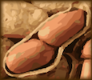
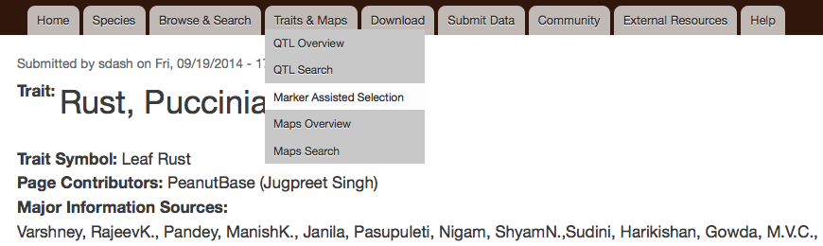
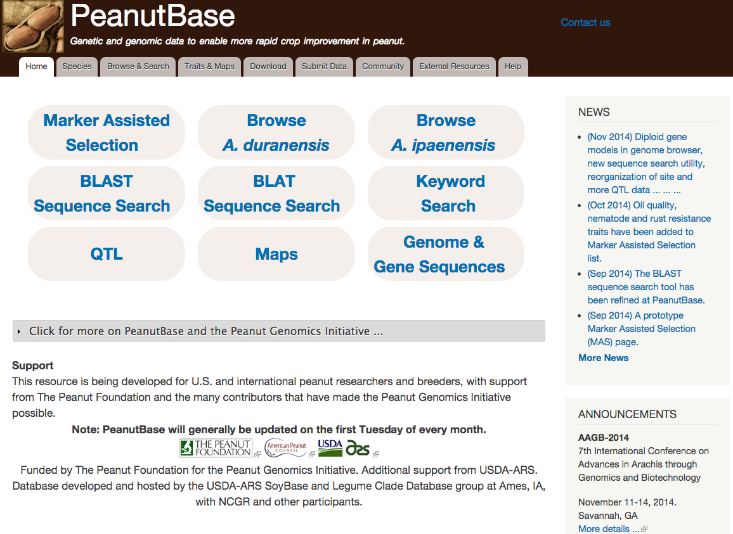
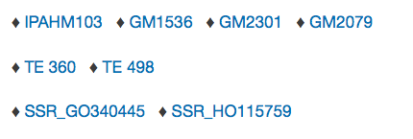
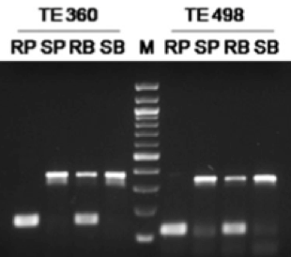
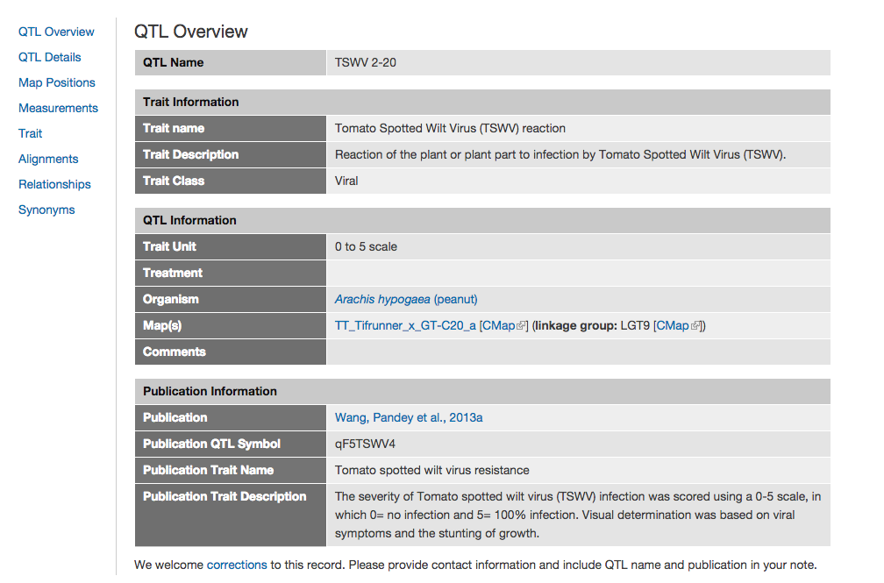
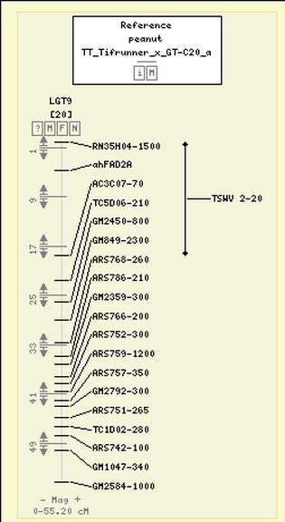
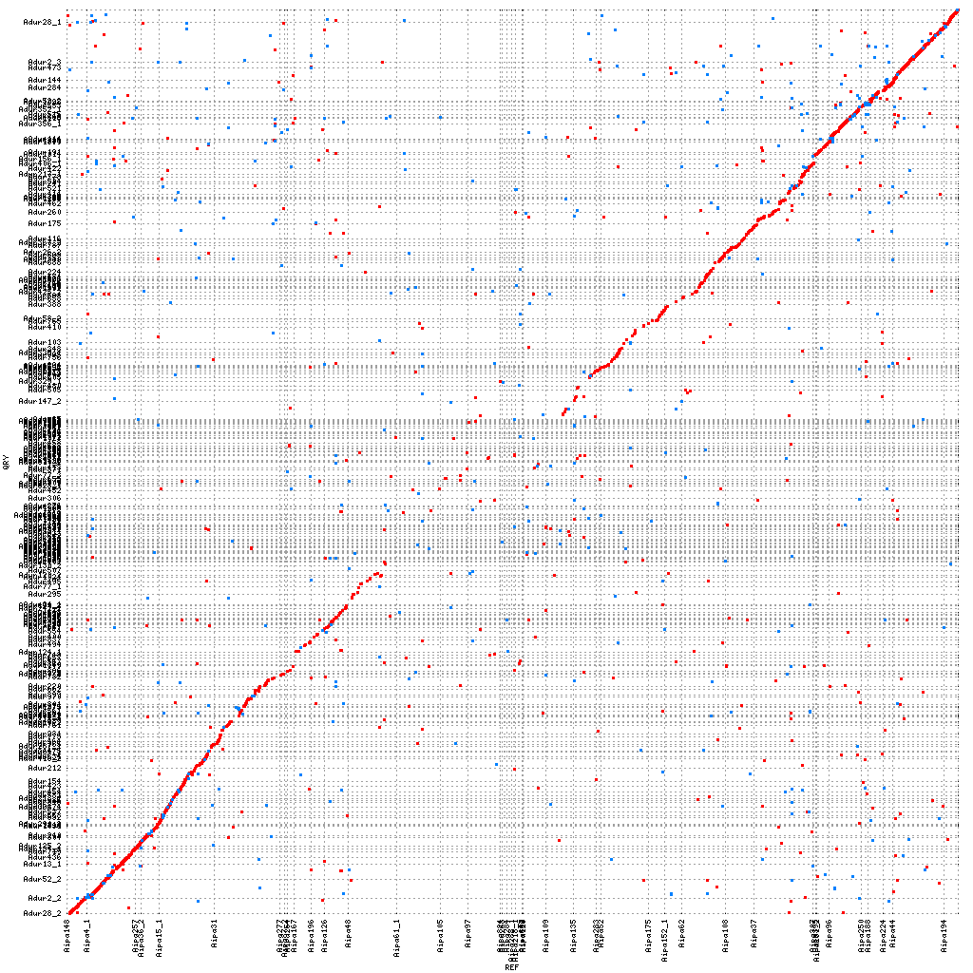
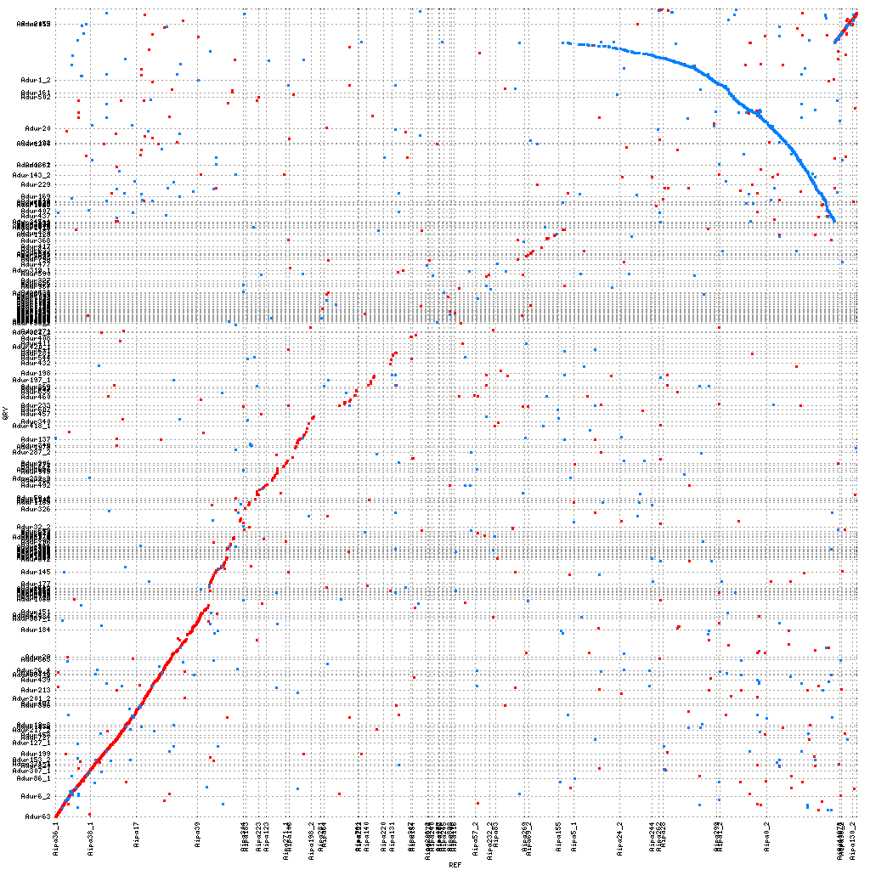
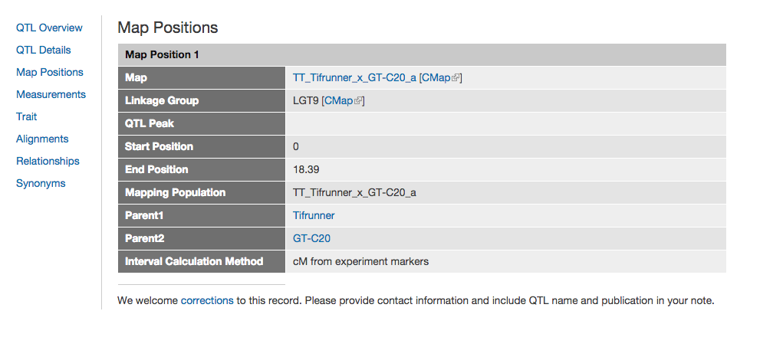
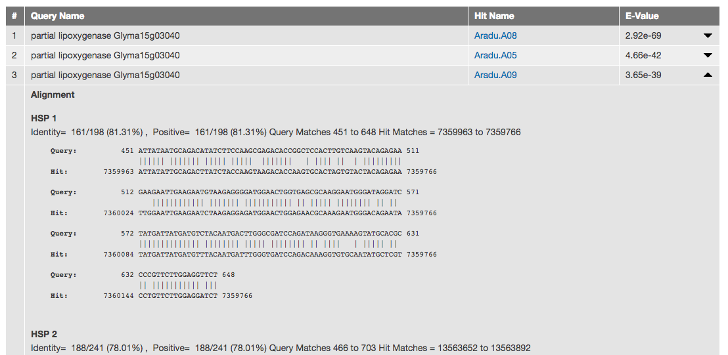
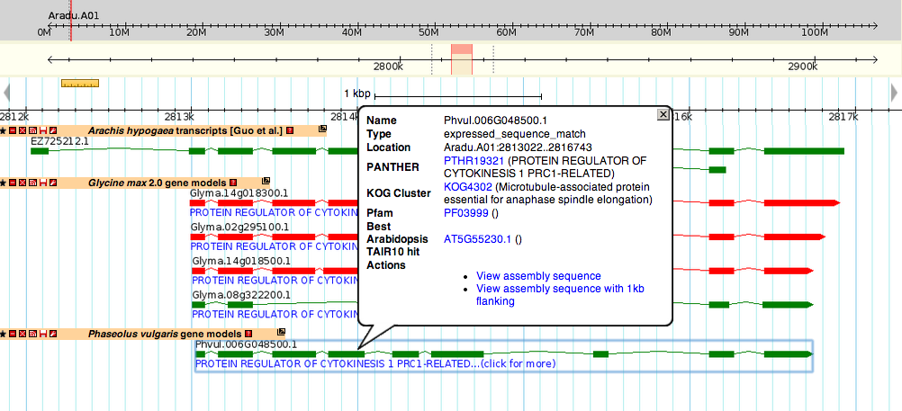
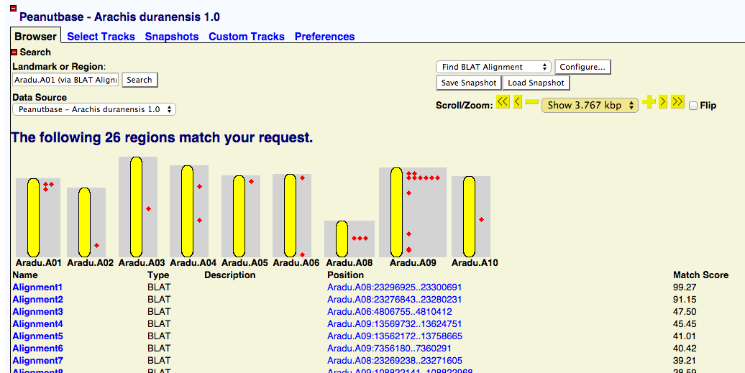
PeanutBase.org
The Genomic Data Portal for Arachis
Ethalinda K.S. Cannon¹, Sudhansu Dash², Scott R. Kalberer³, Wei Huang⁵, Nathan T. Weeks³, Deepak Bitragunta¹, Andrew D. Farmer⁷, Julie A. Dickerson^{1,6}, Steven B. Cannon^{3,5}
¹ Genetics, Development and Cell Biology, ISU; ² Virtual Reality Application Center, ISU; ³ USDA-Agricultural Research Service; ⁵ Agronomy, ISU; ⁶ Electrical and Computer Engineering, ISU; ⁷National Center for Genomic Research
PeanutBase provides peanut researchers and breeders with trait, genetic and genomic data for Arachis and provides means for connecting peanut data to closely related plants with more developed datasets, for example, soybean and common bean.
PeanutBase is being developed in collaboration with the Legume Information System (LIS; http://legumeinfo.org)
Tje
Marker Assisted Selection (MAS)
MAS pages are being created with help from experts in the community on particular traits of interest. Each page combines information and data pertaining to a particular trait.
Markers associated with this trait
Traits, Maps and Markers
PeanutBase curators are developing a consistent trait vocabulary and collecting map, marker, and QTL data from the literature.
Direct contributions from the community are welcome!
Traits and QTL maps – TSWV example
A reference genome assembly for Arachis hypogea
Because of the complexity of the tetrapolid A. hypogea, its likely diploid progenitor species, A. duranensis and A ipaensis were sequenced and assembled first. Although the two species diverged ~ 3 mya, they still maintain significant synteny, although some large rearrangements have occurred.
The two progenitor diploid genomes are remarkably similar….
…but there have been some significant rearrangements as well.
Sequence Search
BLAST and BLAT are available for searching and aligning sequence against the reference assemblies and gene models. Both show the alignments on the reference sequence browsers.
Both genome assemblies can be explored by genome browser and are available as FASTA downloads.
Gene models have been created for both A. duranensis and A. ipaensis using two methods, MAKER-P and GLEAN and are available as genome browser tracks.
Arachis gene models can be compared to Glycine max (soybean) and Phaseolus vulgaris (common bean) gene models to find likely gene function.
Genome Assembly
International Peanut Genome Initiative
PeanutBase.org

